Slide 1
Floc Sed Optimization Team
Final Presentation
August 3rd, 2012
Mary John
Kaditya Naidu
Elizabeth Henderson

Slide 2
Challenges
Run tests varying the following conditions: turbidity, flocculator length, alum dose, flow rate, capture velocity and rate of floc recycle flow
Collect and format data in Mathcad
Maintain floc blanket throughout experiments
Ultimate goal: best performance at lowest cost
Notes:
-

Slide 3
New Challenge
Test to failure
At what flocculator length and alum dose does a floc blanket stop forming?

Slide 4
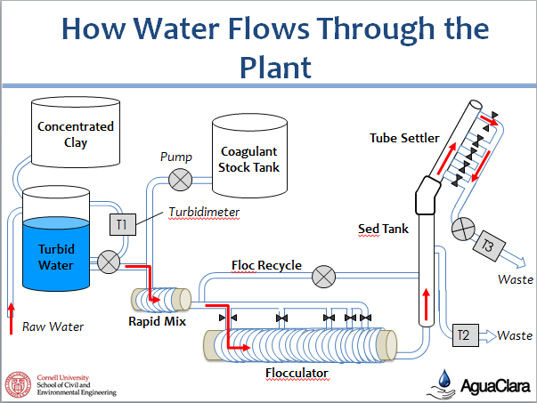

Slide 5
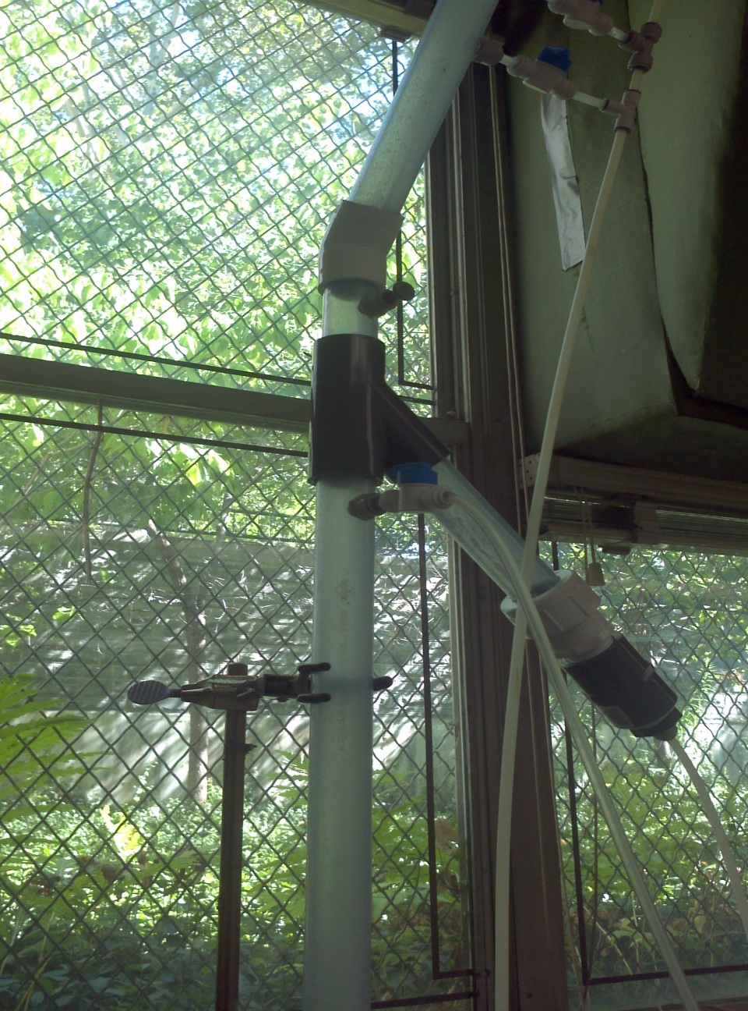

Slide 7
Problems Encountered
Cleaning out the flocculator
Flooding our working space
Calibrating the pump (old-fashioned way)
Nested codes on Mathcad (Slow in rendering results)

Slide 8
Methods
Changed flocculator length
Varied alum doses (60mg/L, 35mg/L, 10mg/L) after one solids residence time
200 NTU influent water

Slide 11
No control run, short on time
Wanted to test system to failure
Assumed it would follow same trend as other two experiments

Slide 12
Results
Floc blankets act as a filter
pC star is higher with floc blankets than without (see control)
Lower alum doses yield similar results as higher alum doses
Possible to reduce flocculator length and alum dose, thus reducing cost
Notes:
-

Slide 13
Floc Blanket Failure
Floc blanket formed at shortest flocculator length and lowest alum dose, 200 NTU water
Reduced turbidity→ 100 NTU
Floc blanket failure occurred between 10mg/L-35mg/L alum dose

Slide 14
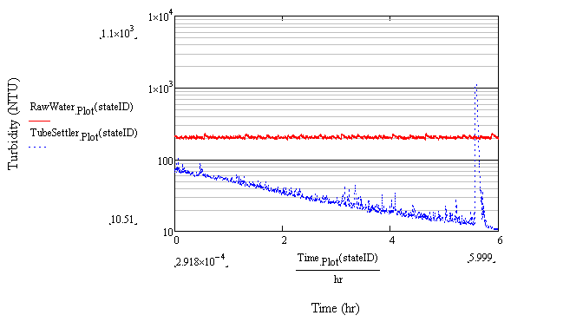
Floc Blanket Formation
200 NTU, 10mg/L alum dose, 2m flocculator

Slide 15
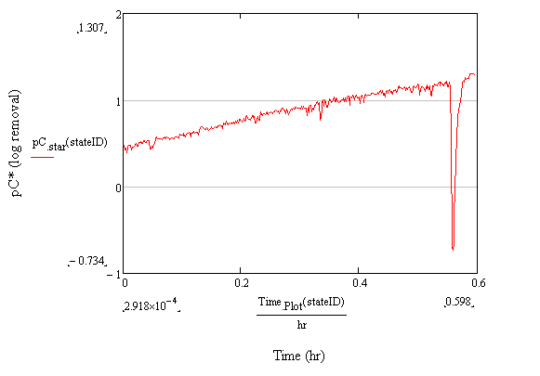
Floc Blanket Formation
200 NTU, 10mg/L alum dose, 2m flocculator

Slide 16
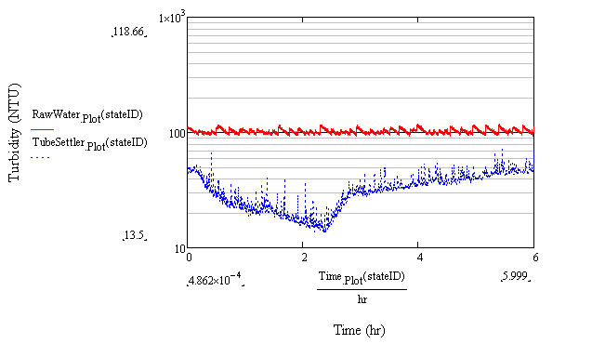
Floc Blanket forms then Falls Apart
100 NTU, 35mg/L alum dose, 2m flocculator

Slide 17
Future Work
Continuing to change variables including flow rate, capture velocity and rate of floc recycle flow
Use this data to determine optimal performance at lowest cost
Continue to test for more specific failure point

